Slide 1
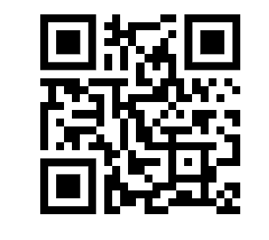
“Ask a Student”: Centering Student Voices in our Coaching Work Through the Use of Student Interviews
Nicora Placa
nicora.placa@gmail.com
@NicoraPlaca
www.nicoraplaca.com

Slide 2
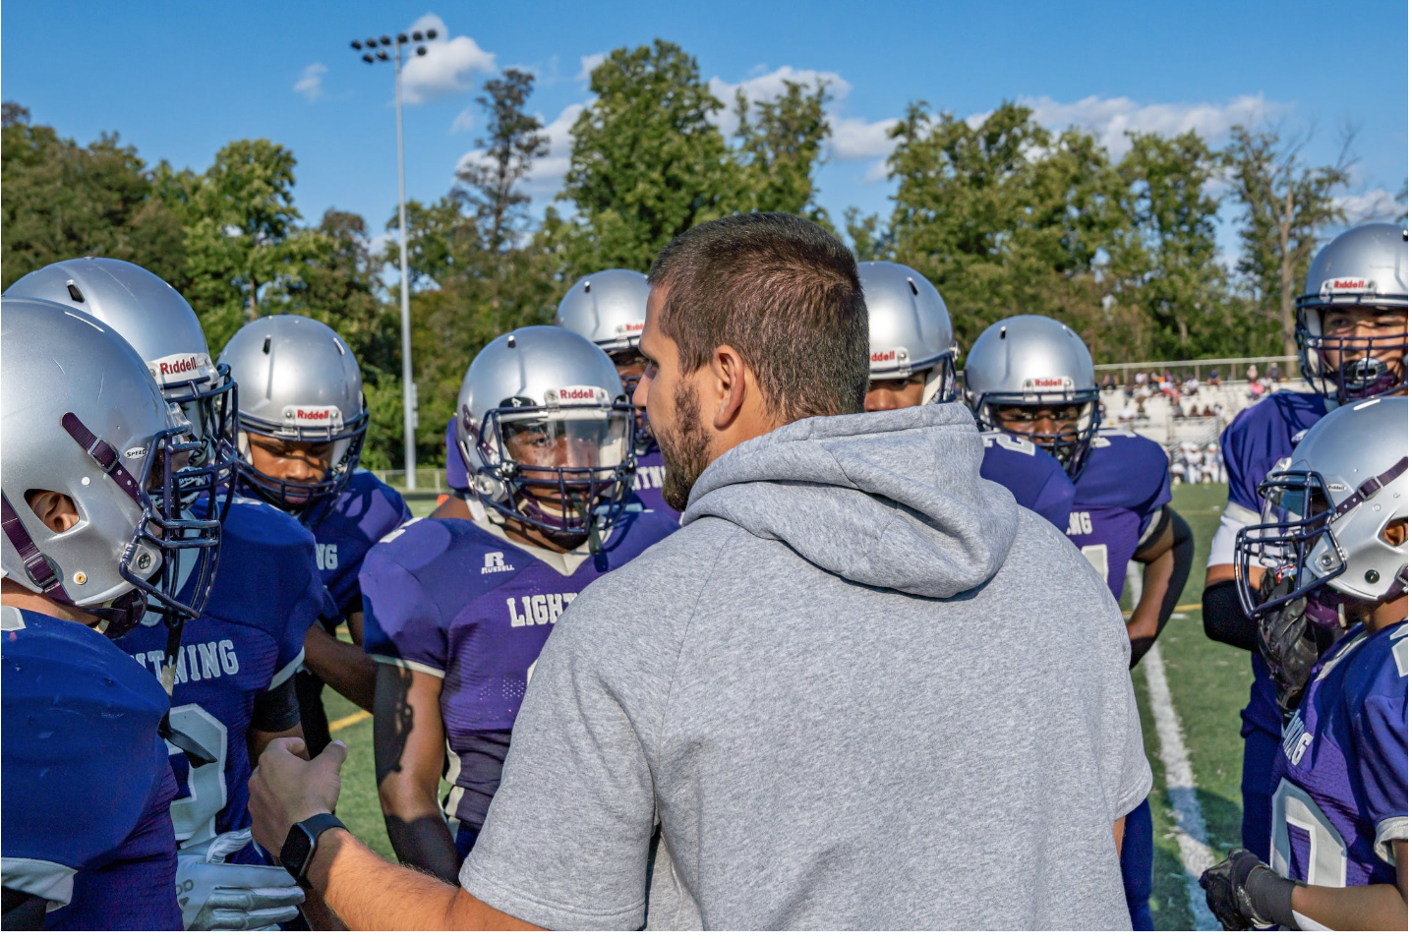
Coaching
Notes:
When I was a new coach, I didn’t have a playbook or curriculum to go off of. I started doing things I saw other coaches do—co planning and co teaching lessons, gathering resources, sharing ideas from the research and and books that I finally had time to read
I was creating some learning for individual teachers but I found that it wasn’t working to create school wide or district wide change.
Why was that? The team doesn’t learn from one another. I was ping ponging from teacher to teacher and I wasn’t leveraging the strengths of the team
So I started to rethink my role and I realized I didn’t need to go back to square one. I could go back to what I did know about creating learning within elementary and middle school classes and apply that to my new context of woking with teachers.

Slide 3
What opportunities
do students need to learn math?

Slide 4
Students need opportunities to...
Construct knowledge on their own
Explore new ideas
Practice new skills
Take risks and make mistakes
Examine and discuss each others’ work and strategies
Work independently, in small groups and in a whole group
Notes:
as opposed to following a model of how to do the problem

Slide 5
Is this also true for teachers?

Slide 6
Teachers need opportunities to...
Construct knowledge on their own
Explore new ideas
Practice new skills
Take risks and make mistakes
Examine and discuss each others’ work and strategies
Work independently, in small groups and in a whole group
Notes:
as opposed to following a model of how to do the problem

Slide 7
In addition to individual coaching,
how do we design and facilitate
learning opportunities for the team?
Notes:
The coach’s role is NOT to be the expert or model lessons or best practices
This is similar to my role as a reacher

Slide 8
Collaborative Coaching Toolbox
Tool 1: Building Teams
Tool 2: Student Interviews
Tool 3: Visiting Classrooms
Tool 4: Learning Walks
Tool 5: Rehearsing Routines
Tool 6: Lesson Study

Slide 10
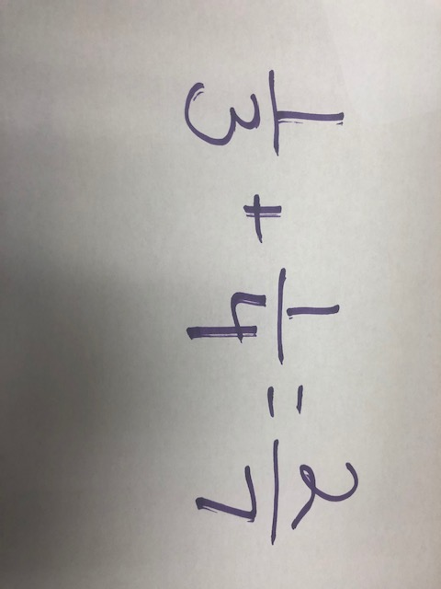
Notes:
Me: I see you added the numerators and denominators. Are those the same size pieces?
Student: Yes?
Me: Are you SURE those pieces are the same size?
Student: Um. No?
Me: Good! So what do we do if they aren’t the same size?
Student: Um….
Me: I’ll give you a hint. We worked on it yesterday. We need to find….
Student: The same size?
Me: Yes. We need to find common……
Student: ummmmm…..denominators?
Me: Yes. Very good! We need to find common denominators. Why don’t you review your notes from yesterday or look at the anchor chart on how to find the common denominator and then re-do this?

Slide 11
Why is it so hard to listen?
Think about some of the challenges
of listening and responding to students.
Notes:
Listening only for the right answer
Listening only for a particular solution path
Thinking about the next instructional move instead of listening to the student
Assuming that students are thinking the same way we are thinking
Not listening for what students know
Not listening for the informal knowledge students bring to the problem
Not trying to make sense of what students are doing

Slide 12
Challenges
Listening only for the right answer or a particular solution path
Thinking about the next instructional move
Assuming that students are thinking the same way you
Not trying to make sense of what students are doing
Notes:
Give example here

Slide 13
How can we design and facilitate
learning opportunities for the team
that address these challenges?

Slide 14
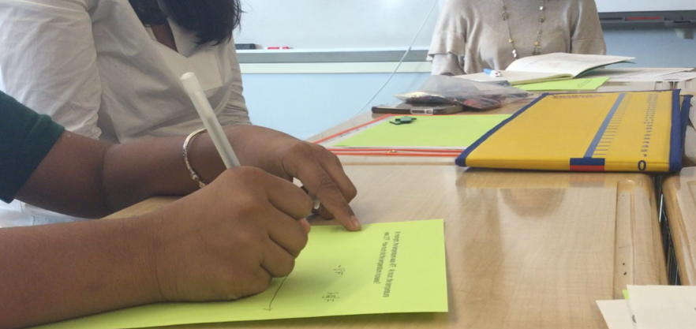
Student Interviews
Notes:
Gather information about how a student is thinking.
They are not designed to be teaching sessions,
They require flexible questioning

Slide 15
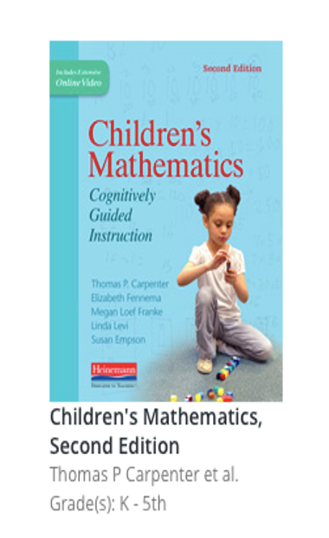
Cognitively Guided Instruction (CGI)
“The more you listen to students' mathematical thinking, the more you will be amazed by what students can do…”
Marilyn Burns
“I’m now convinced that listening to students, one on one, provides access into how they reason in a way that’s unique and valuable.”

Slide 16
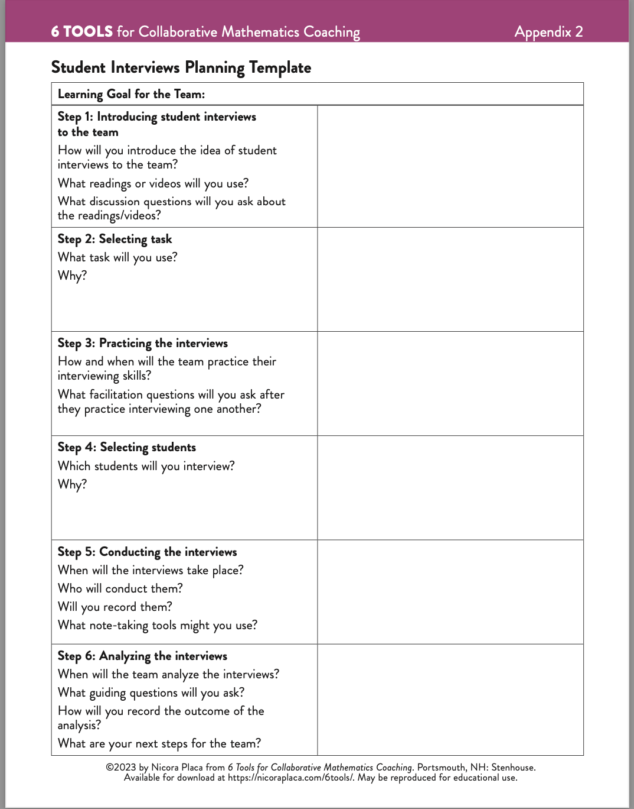
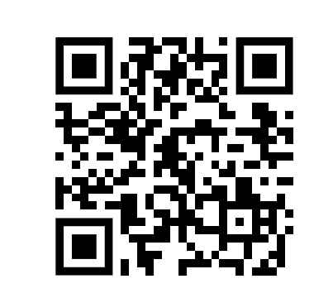
Learning Plan
Step 1: Introduce student interviews
Step 2: Select Tasks
Step 3: Practice Interviewing
Step 4: Select Students
Step 5: Conduct Interviews
Step 6: Analyze interviews
https://nicoraplaca.com/tool-2/

Slide 17
Step 1: Introducing Interviews to the Team

Slide 18
Step 2: Select Tasks
Before a new unit
What do students already know?
What intuitions do they have?
During/After a unit
Why are students struggling with a particular question?
What do they really understand about the content?
When we are trying out new tasks or ideas
“I wonder how kids will think about that....”
“I don’t think my kids can do that….”

Slide 19
Step 3: Practice Interviews

Slide 20
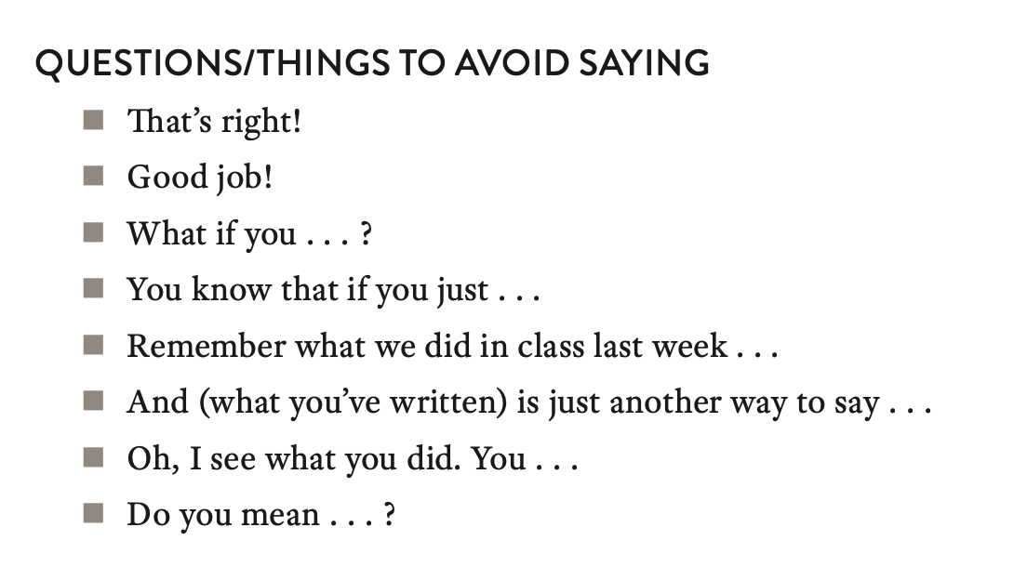
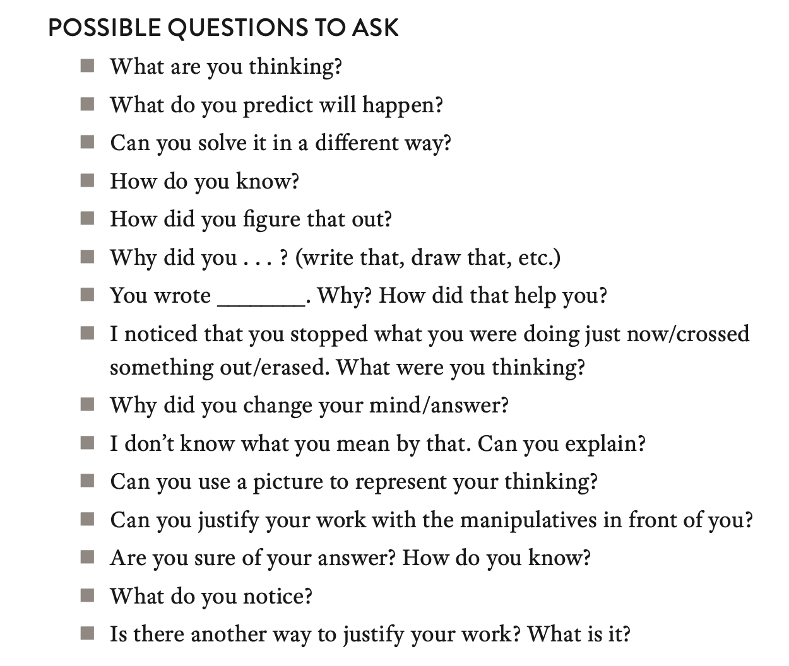
Interview Questions/Prompts

Slide 21
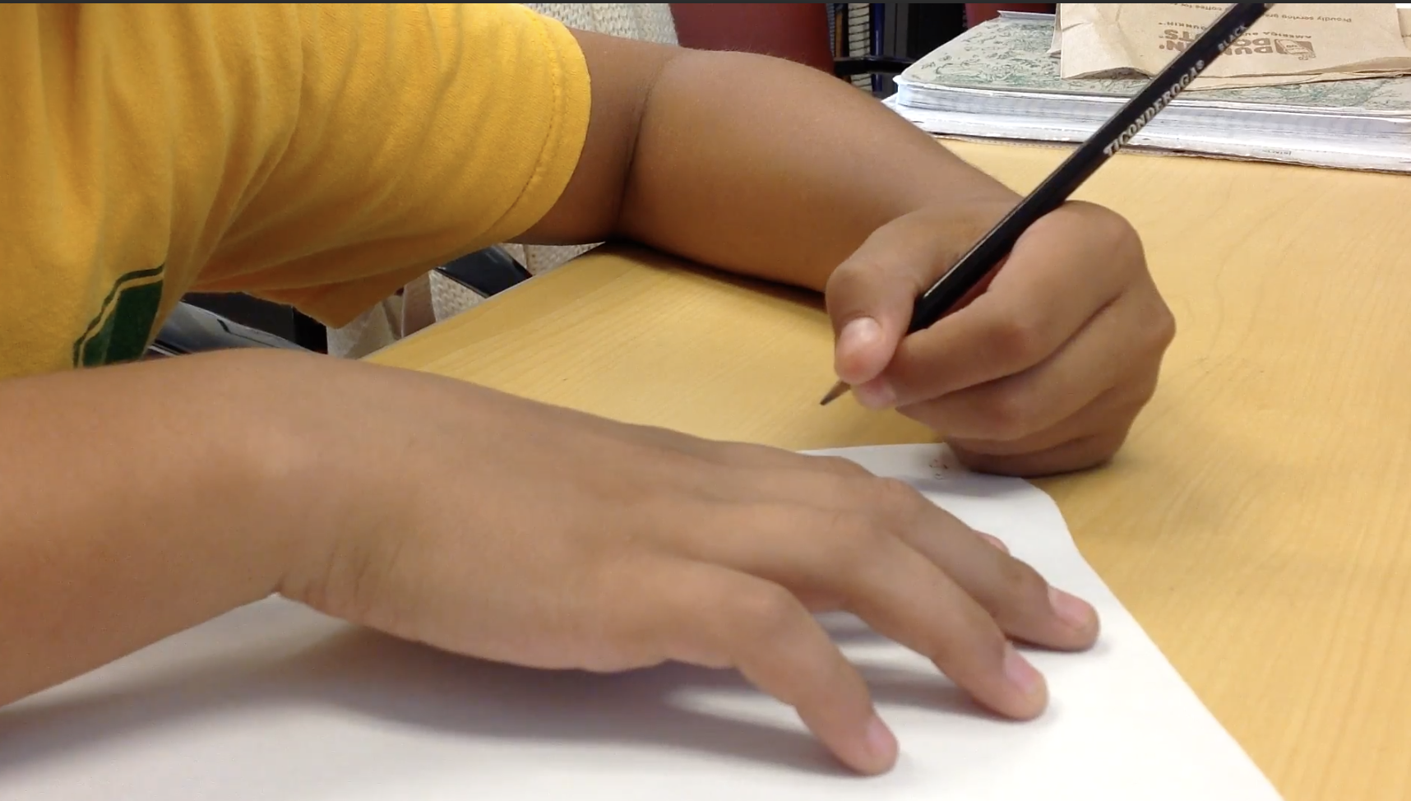
Step 4: Select Students

Slide 22
Step 5: Conduct the Interview
Notes:
Students rarely have this much time to answer a question in a classroom
Letting the student explain their thinking leads them to revise it
They demonstrate interesting ideas about place value and decomposing and recomposing numbers

Slide 23
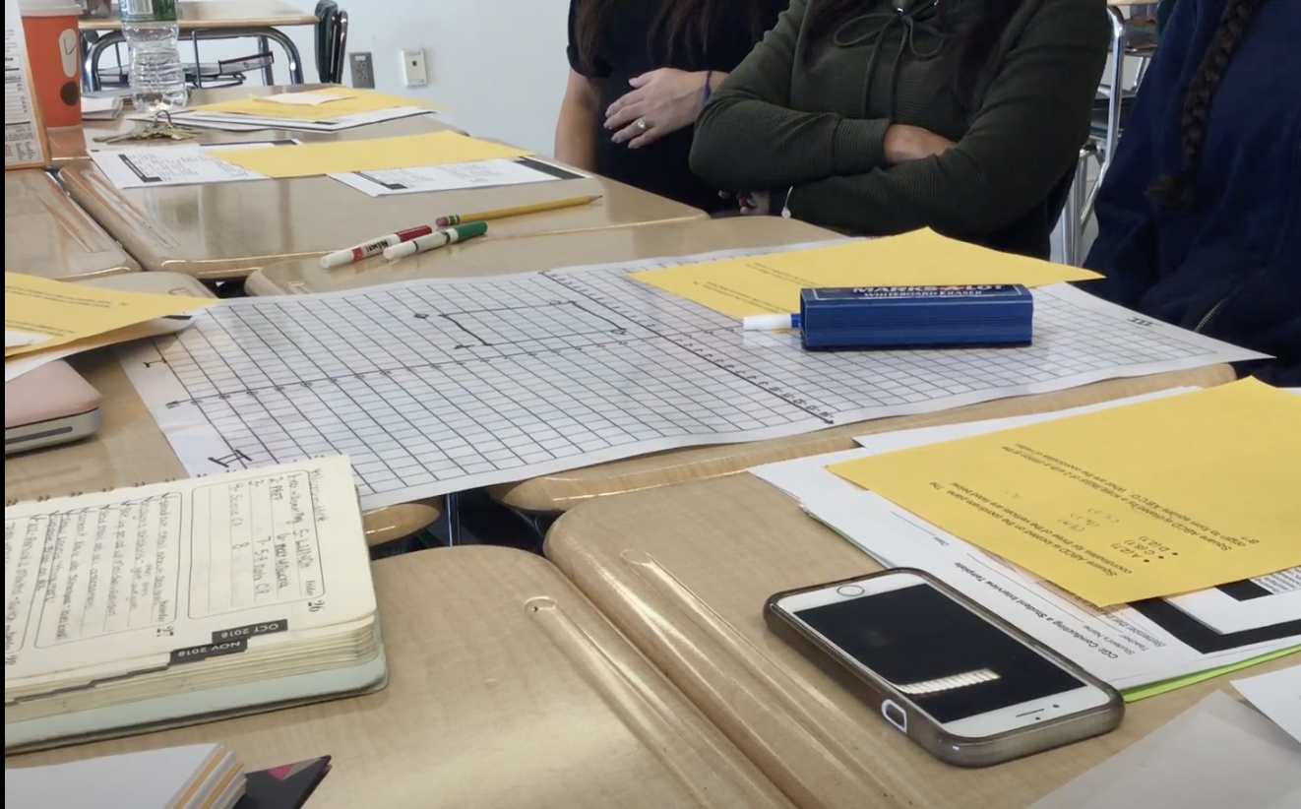
Step 6: Debrief/Analysis
Notes:
Assume that what students are doing makes sense to them and figure out why
Don’t assume they are thinking the same way you do.

Slide 24
Step 6: Analyzing the Interviews

Slide 25
Step 6: Generalizing our learning

Slide 26
Let’s Watch
A Teacher Team in Action

Slide 27
6th Grade Task
-3 + 5
-10 + -2
Notes:
Give background info on this task—6th grade team was strugglign with it

Slide 28
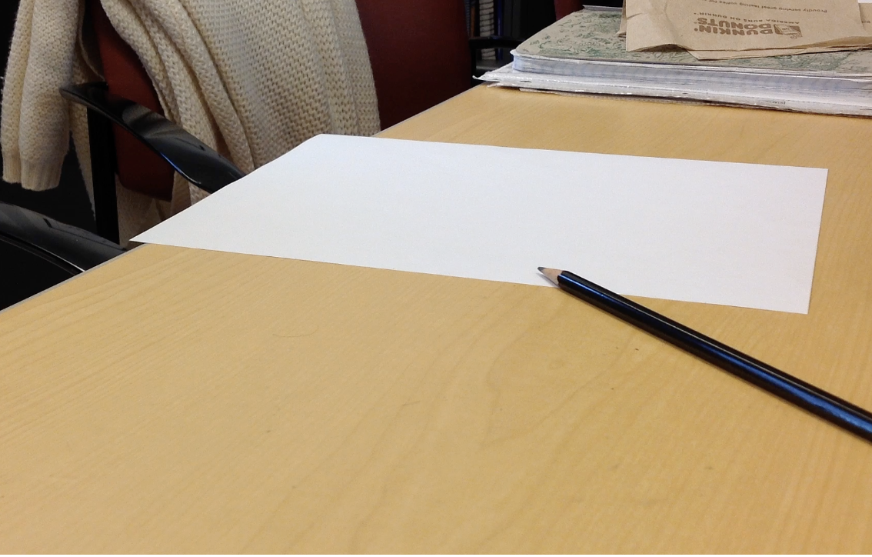
Video

Slide 29
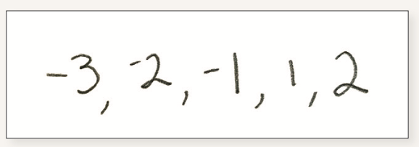
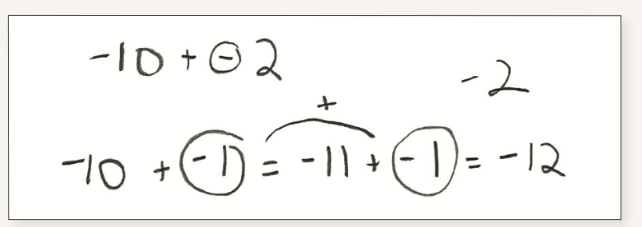
Video
What did you notice about the students’ thinking?
What did you notice about the team’s questioning?
Notes:
What missed opportunities were there to probe student thinking?
What are some possible goals you might have for the debrief?
What questions might you ask?

Slide 30
Turn and Talk
How would you frame the conversation with the teacher team that was watching this video?
What might be your goal?
What questions might you ask?

Slide 31
What’s the impact?
Pedagogical Content Knowledge
Listening to and making sense of student thinking
Curiosity about student thinking: “Let’s ask a kid”
Developing an Asset-Based View of Students
Notes:
They complement student work analysis nicely because we can learn about what students DO understand

Slide 32
Let’s go back to this example….

Slide 33
Final Thoughts
Collaborative coaching tools create opportunities for us to learn together and take risks
Tools like Student Interviews focus on foregrounding student learning and student thinking
Notes:
Helps coordinate the work

Slide 34
How will you create opportunities for teachers to..
Construct knowledge on their own
Explore new ideas
Practice new skills
Take risks and make mistakes
Examine and discuss each others’ work and strategies
Work independently, in small groups and in whole groups
Notes:
as opposed to following a model of how to do the problem

Slide 35
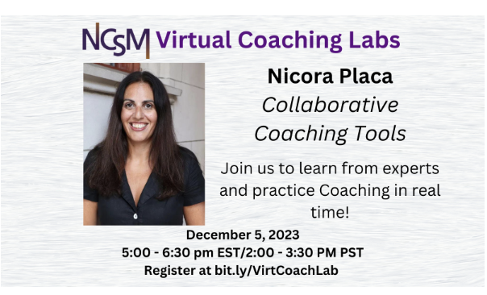
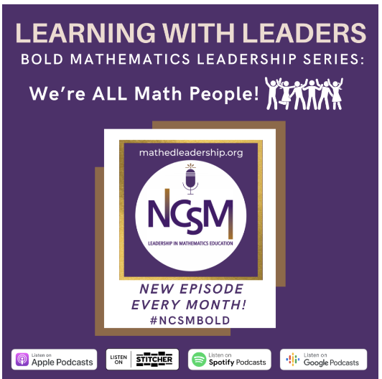
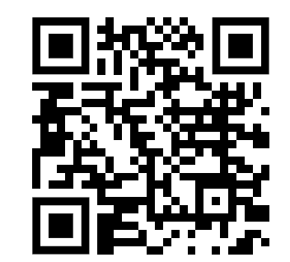
Want to learn more?
Math Coaches Virtual PLN
December 7th 6:30-7:45 EST
Episode 85
https://www.mathedleadership.org/

Slide 36
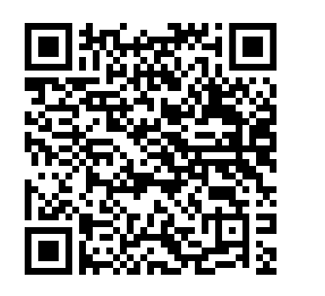
Stay in touch
Email: nicora.placa@gmail.com
Twitter: @nicoraplaca
Website:www.nicoraplaca.com
Use promo code: NCTM 23
for 25% off

